Slide 1
The Expanding Role of Advanced Imagine in Glioblastoma
Alexander Radbruch, MD, JD
Department of Neuroradiology
University of Heidelberg
Heidelberg, Germany

Slide 2
Advanced imaging techniques for…
Differential diagnosis
Identification of pseudoprogression
Identification of pseudoregression / T2-progress

Slide 3
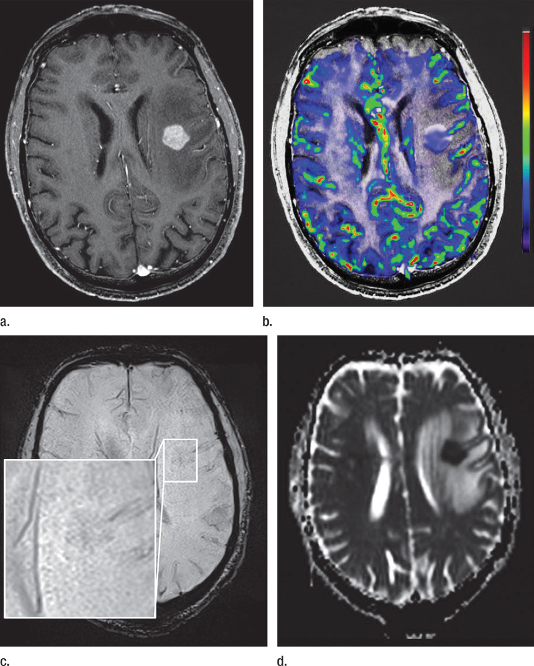
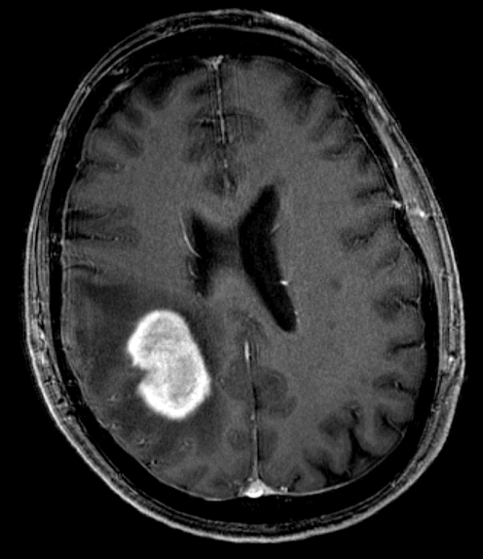
Advanced MRI for Differential Diagnosis: PCNSL vs GBM
GBM: Surgery + RCT
PCNSL: No surgery!
Notes:
Both homogenously enhancing mass
One patient atypical gbm, one patient pcnsl
On the basis of ce t1 it is not possible to differentiate

Slide 4
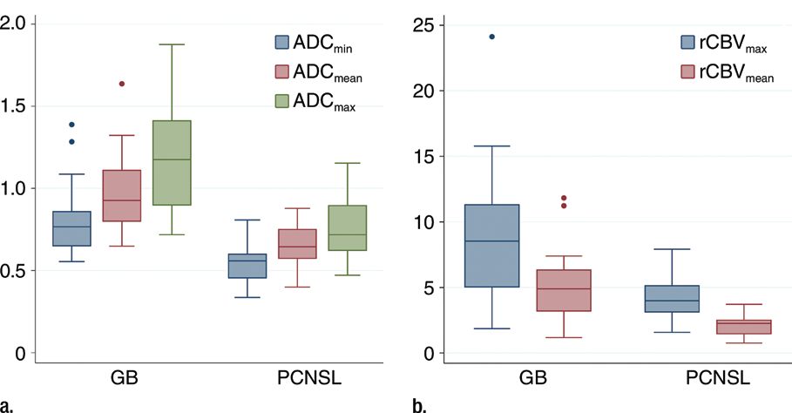

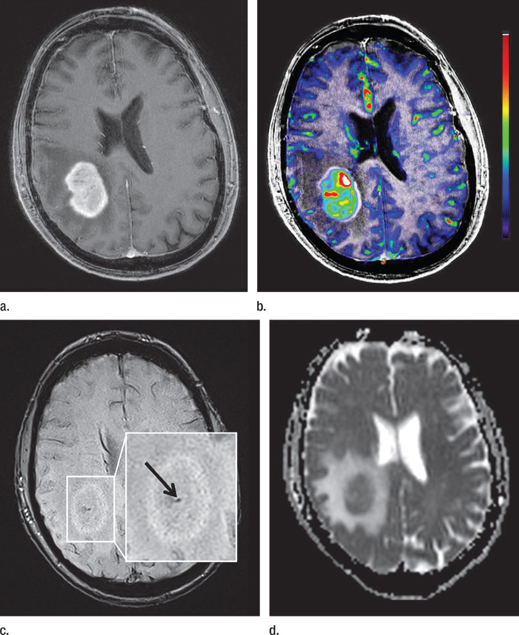
Diffusion Imaging: PCNSL vs GBM
PCNSL: Low ADC
High Cellularity
ADC values (mm²/sec)
GBM: High ADC
Lower Cellularity
Kickingereder P, et al. AJNR Am J Neuroradiol. 2014;35(8):1503-1508.

Slide 5
DCE Perfusion
T1 effect
Assessment of the BBB (k_{trans})
Scan time 4 - 10 min

Slide 6
DCE Perfusion
DSC Perfusion
T1 effect
Assessment of the BBB (k_{trans})
Scan time 4 - 10 min
T2* effect
Assessment of CBV
Scan time 1:30 min
Correction techniques needed

Slide 7

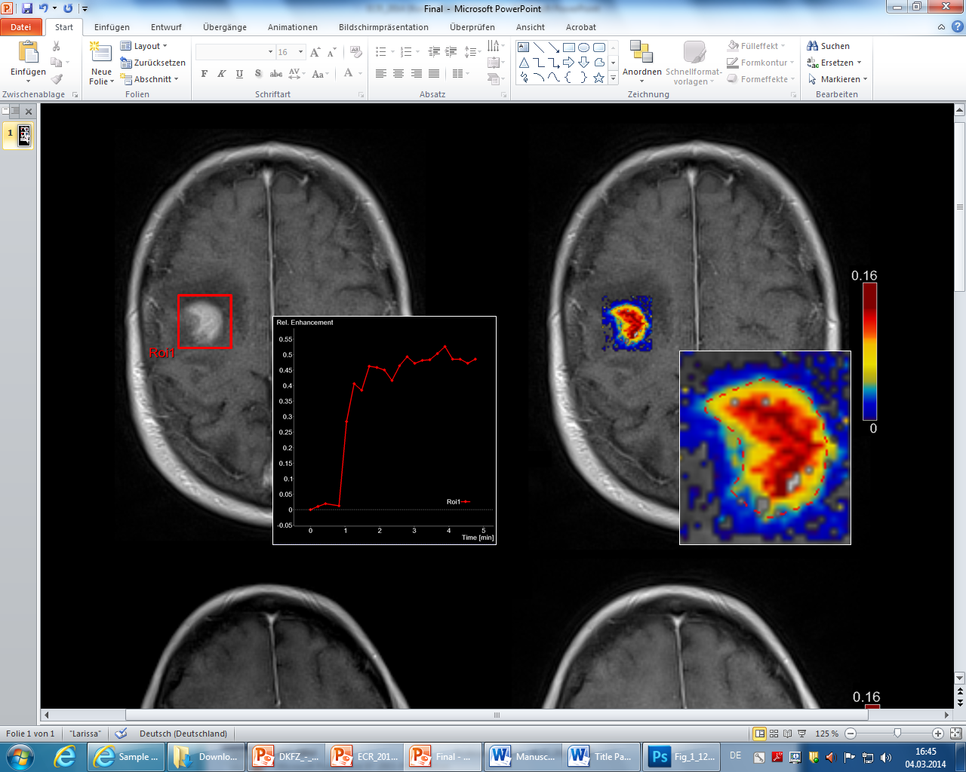
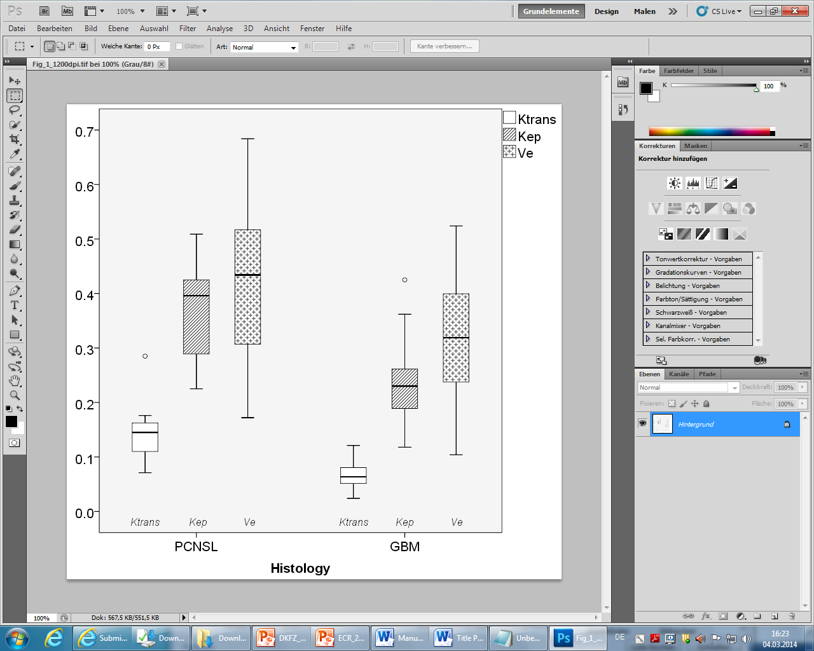
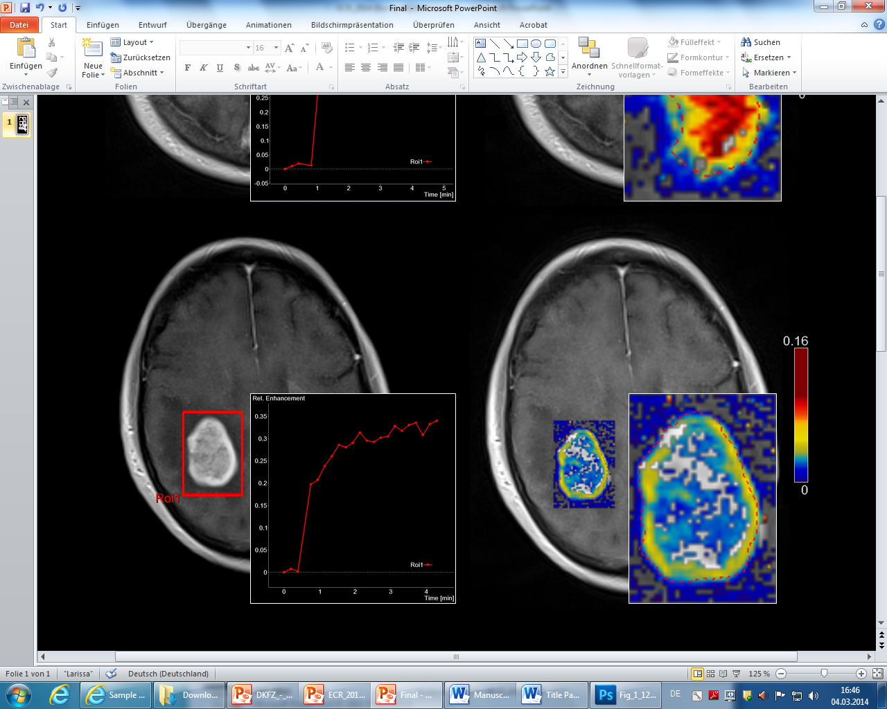
DCE-Perfusion: PCNSL vs GBM
PCNSL: High k_{trans}
Severe Damage of BBB
GBM: Lower k_{trans}
moderate damage of BBB
Kickingereder P, et al. AJNR Am J Neuroradiol. 2014;35(8):1503-1508.

Slide 8
DSC-Perfusion: PCNSL vs GBM
PCNSL: low CBV
low vascularity
GBM: high CBV
high vascularity
Kickingereder P, et al. AJNR Am J Neuroradiol. 2014;35(8):1503-1508.

Slide 9
DSC-Perfusion: PCNSL vs GBM
PCNSL
PCNSL: No microbleeds
GBM: microbleeds
GBM
Kickingereder P, et al. AJNR Am J Neuroradiol. 2014;35(8):1503-1508.

Slide 10
Advanced imaging techniques for…
Differential diagnosis
Identification of pseudoprogression
Identification of pseudoregression / T2-progress

Slide 11
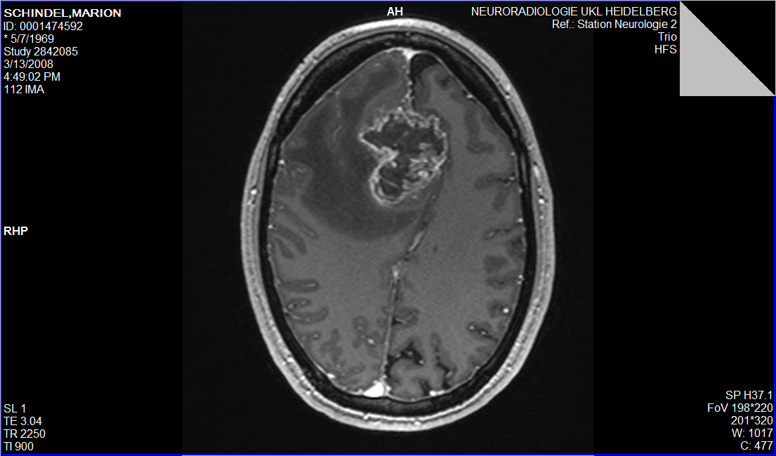
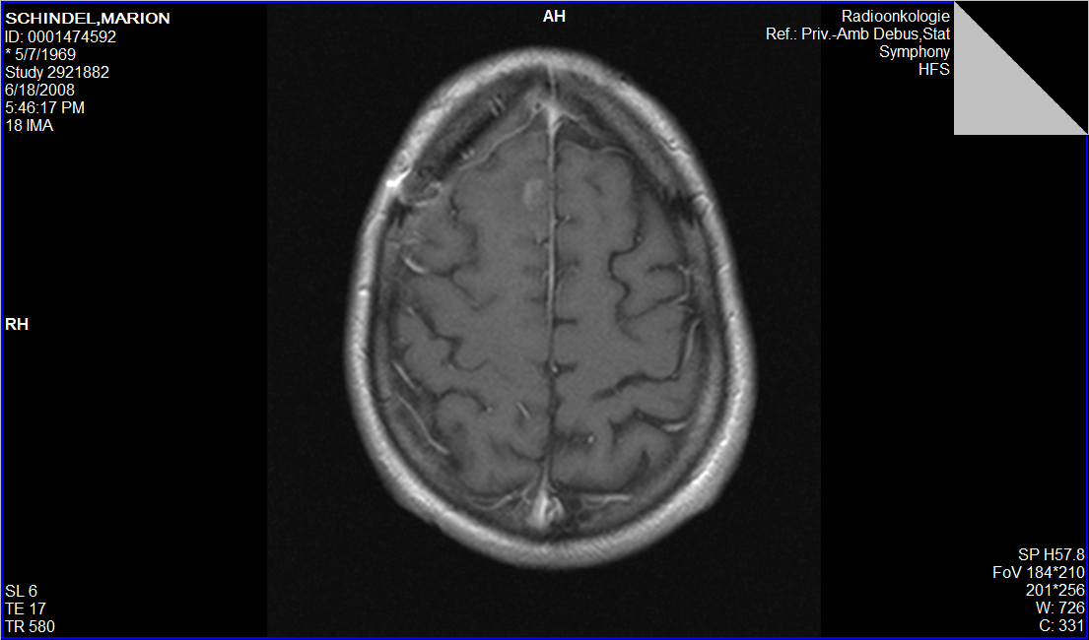
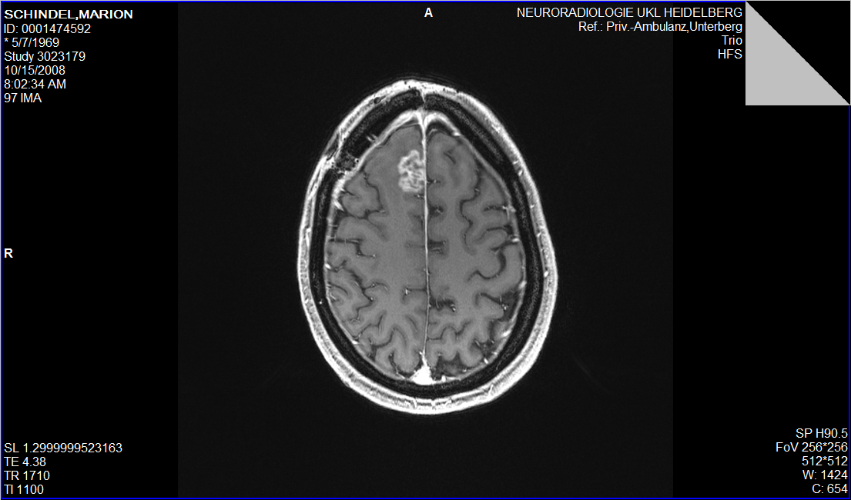
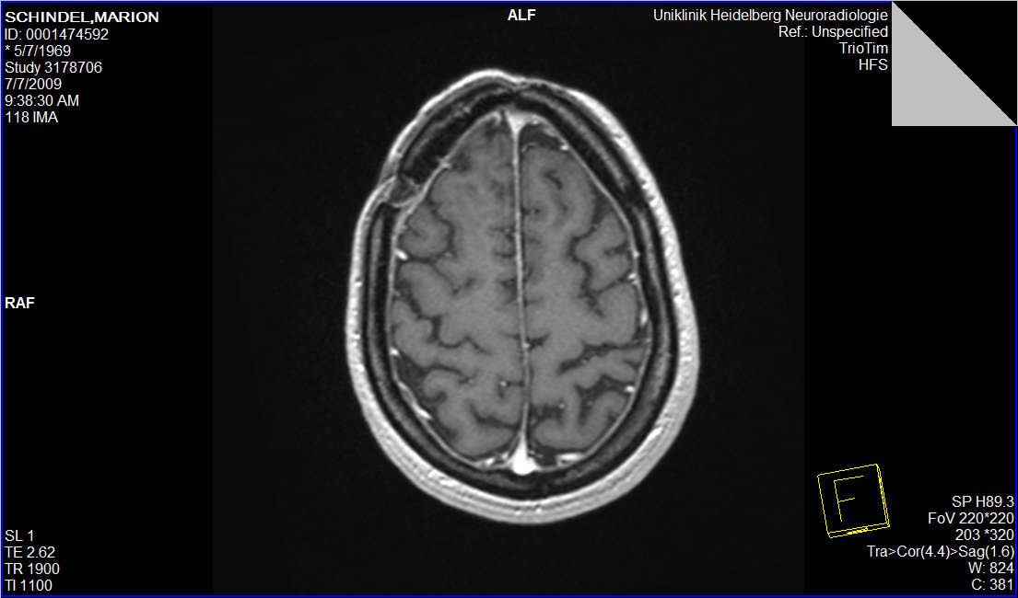
Pseudoprogression
Pre-OP
Post-OP
3 months post-OP (standard RCT)
6 months post-OP

Slide 12
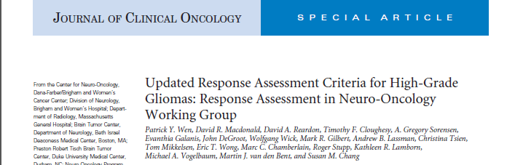
RANO-Criteria
“within the first 12 weeks of completion of radiotherapy, progression can only be determined, if the majority of the new enhancement is outside of the radiation field“
Danger: Delay of the necessary change of therapy in the most aggressive tumors, that recurr early

Slide 13
Differentiation with Diffusion and DSC Perfusion
Hypothesis Diffusion
Hypothesis DSC Perfusion
True Progression: Increased Cellularity – Decreased ADC
Pseudoprogression: Decreased Cellularity – increased ADC
True Progression: Increased vascularity – Increased CBV
Pseudoprogression: decreased vascularity – decreased CBV

Slide 14
Challenge: Postprocessing
Parametric Response Maps:
Region of Interest Analysis does not reflect the heterogeneity of GBM
Parametric Response Maps*: Voxelwise analysis of changes in ADC/CBV values
*Galban CJ, et al. Nat Med. 2009;15(5): 572–576.

Slide 15
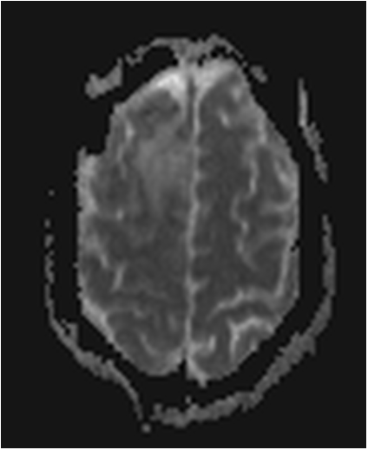
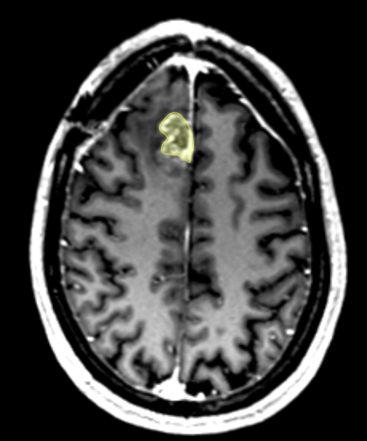
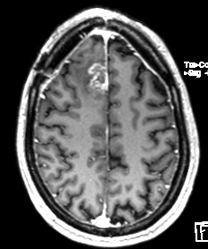
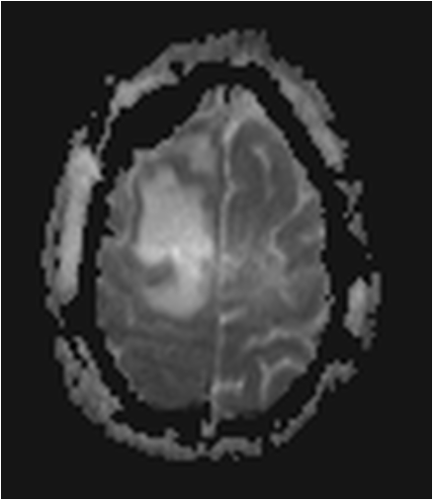
Workflow: 1. Step
1. ROI delineated on ce-T1 follow up
2. coregistration and transfer of ROI to ADC baseline and ADC f/u
baseline ADC
3. calculation of rADC values by division of ROI with contralateral reference-ROI
new enhancement at 3 months
3 months ADC

Slide 16

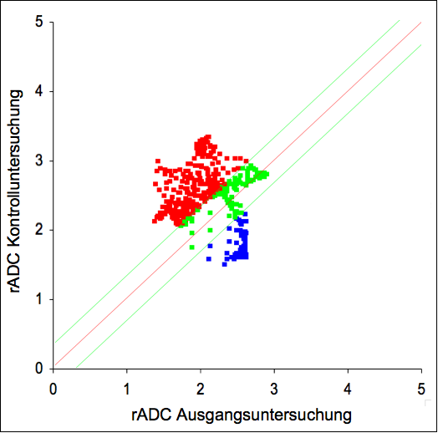
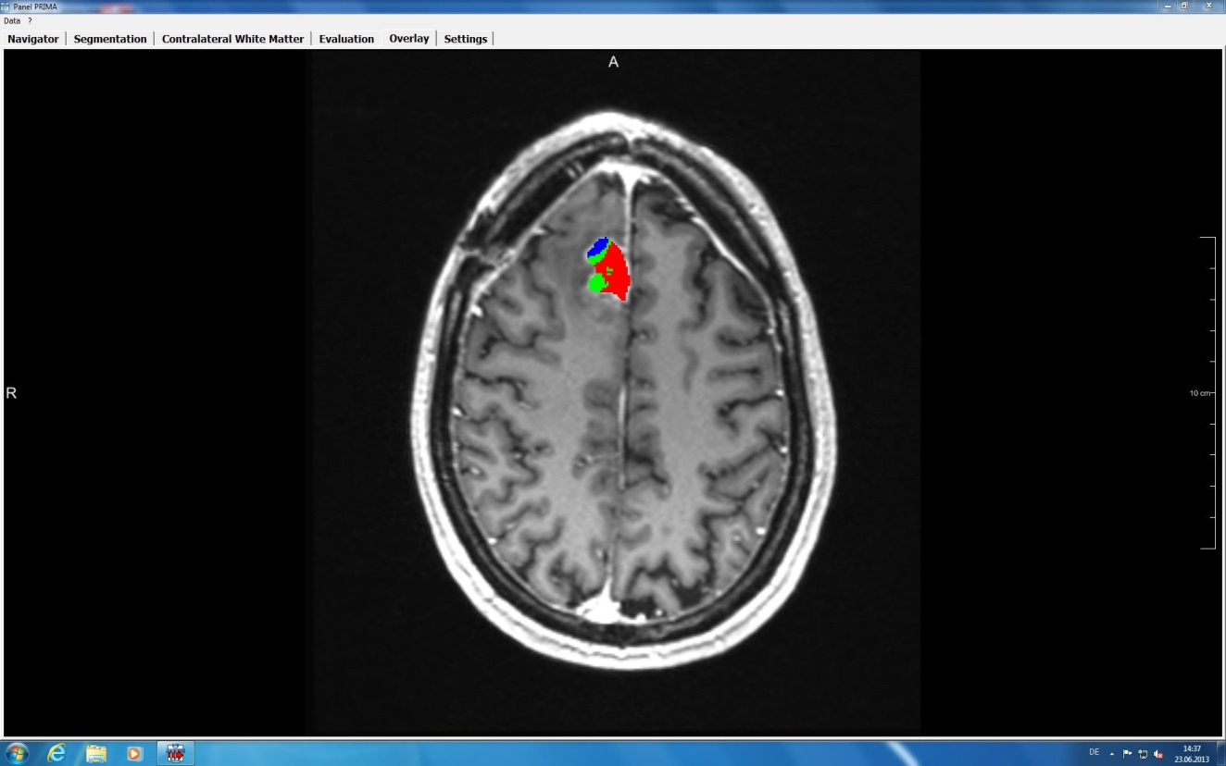
Workflow: 2. Step
rADC follow up
rADC Baseline
Voxelwise Subtraction of rADC values at baseline and follow up, presentation with scatter plott
Visualization on follow up ce-T1
Quantification of voxels
1) rADC (baseline) – rADC (follow up) > 0.25
2) rADC (baseline) – rADC (follow up) < -0.25 (Increase of ADC) red
(Decrease of rADC) blue
(Increase of rADC)

Slide 17
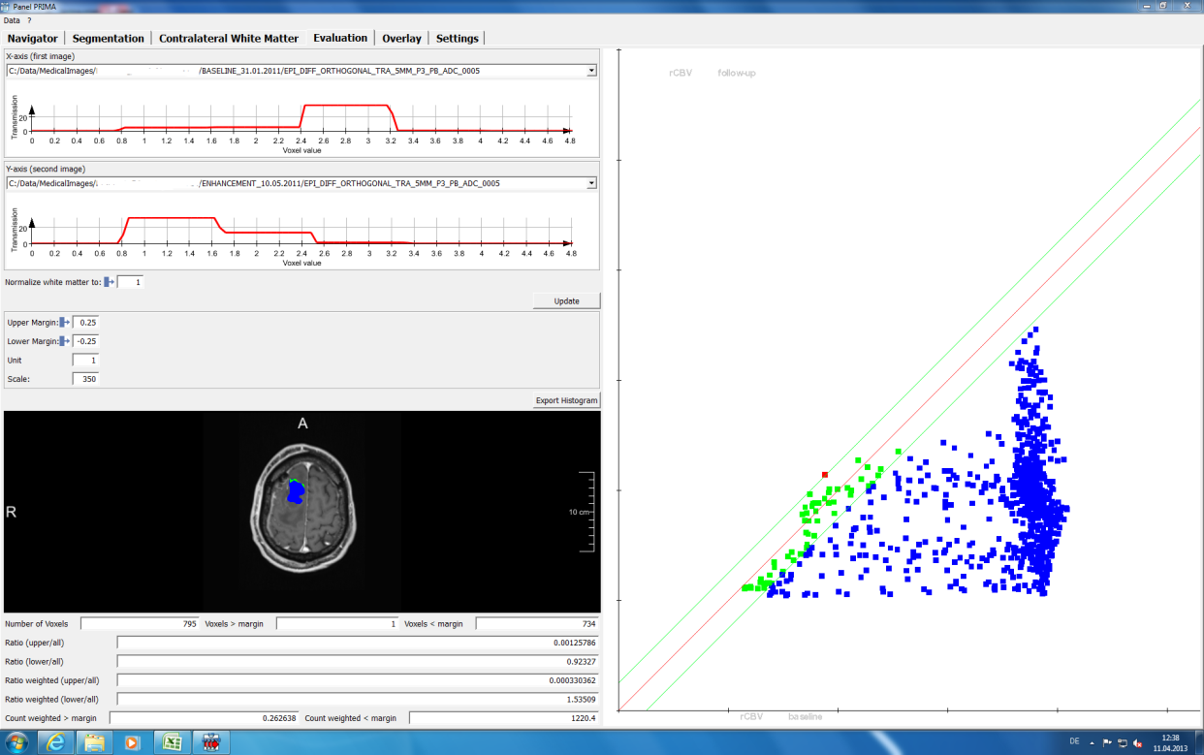
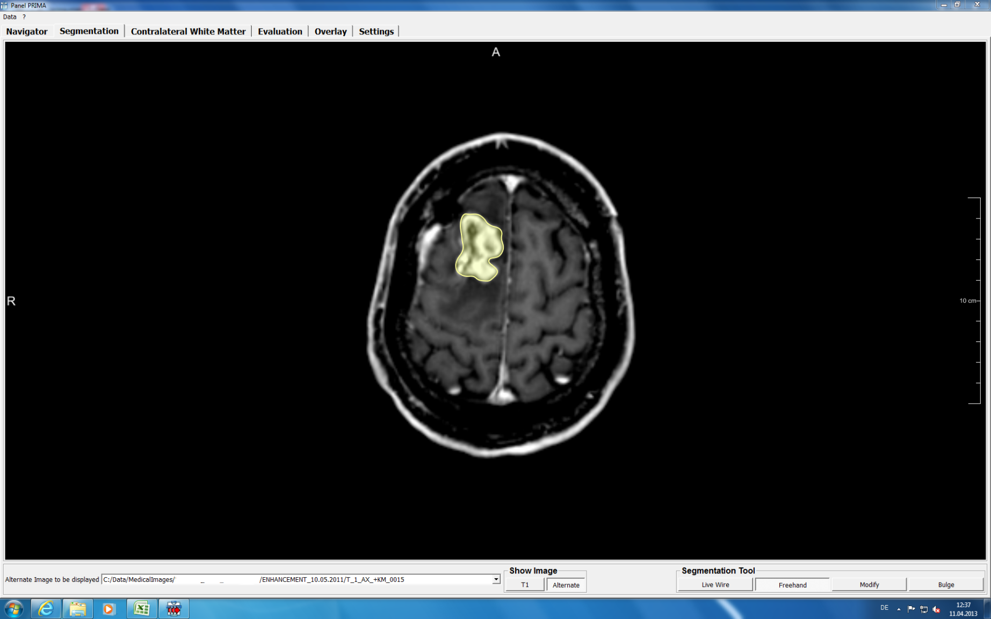
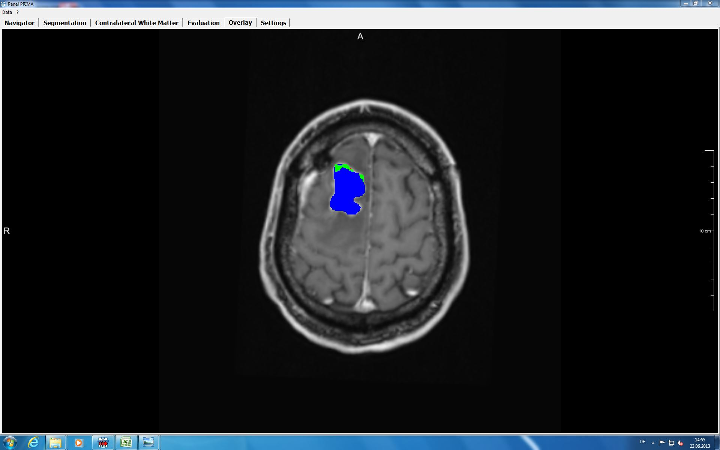
Example: Pseudo-progression
rADC follow up
rADC Baseline
Example: True Progression
rADC follow up
rADC Baseline
Radbruch A, et al. Presented at the 99th Scientific Assembly and Annual Meeting of the Radiological Society of North America. Chicago, Illinois, United States. December 1-6, 2013. Abstract SSM15-02.

Slide 18
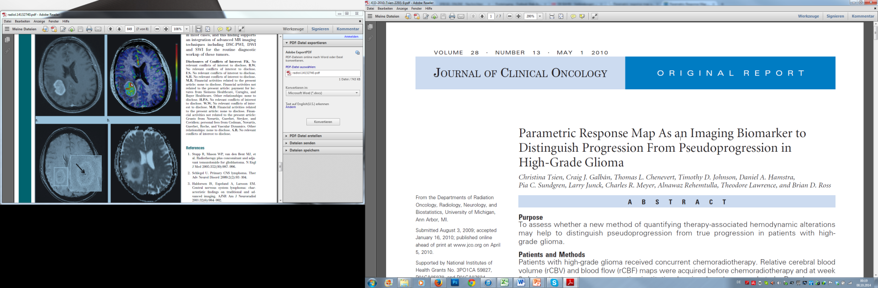
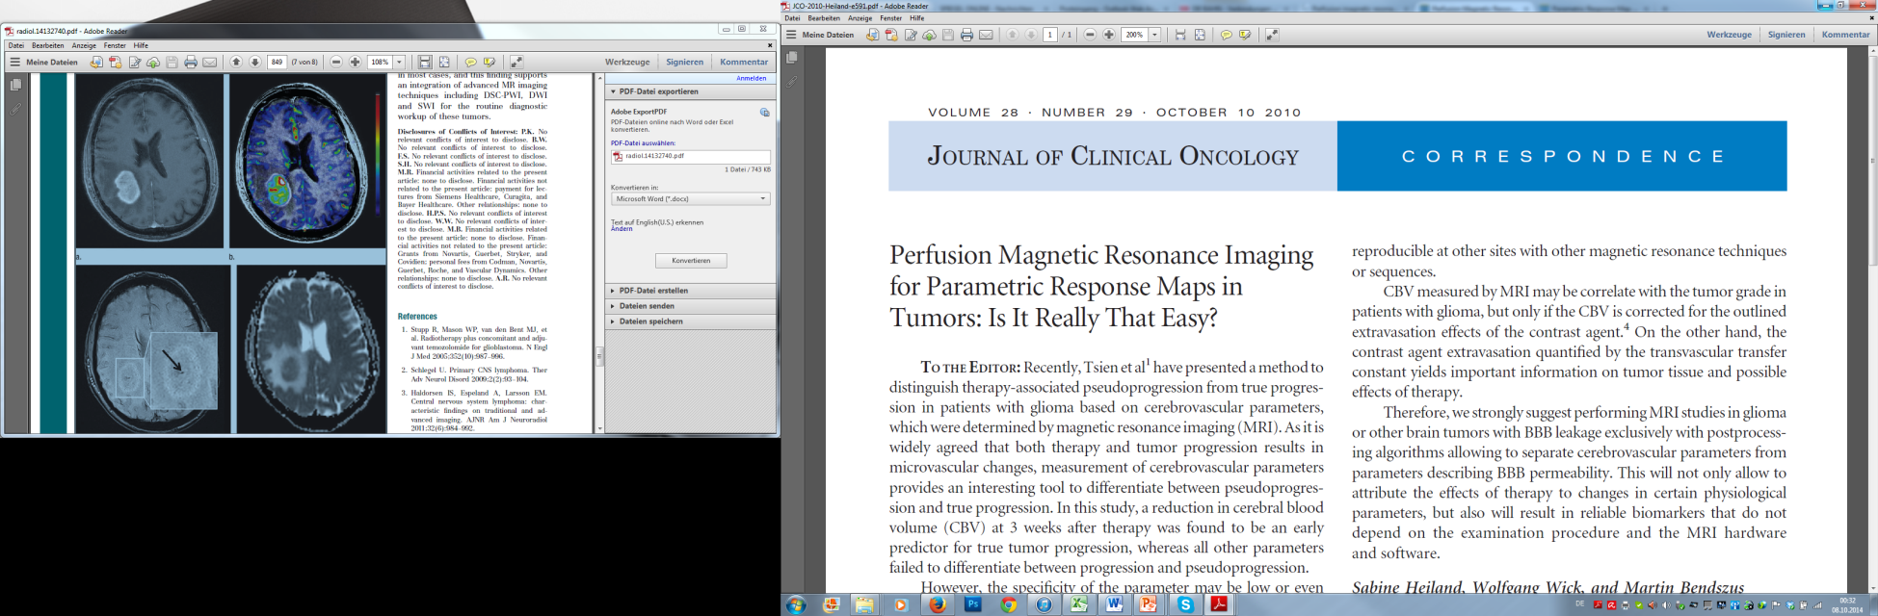
Parametric Response Maps for DSC-Perfusion
Findings:
Decreased CBV – True Progression;
Increased CBV - Pseudoprogression
?
Comment by Heiland et al:
Correction techniques are needed for DSC Perfusion in case of a disrupted BBB
Otherwise: Underestimation of CBV

Slide 19
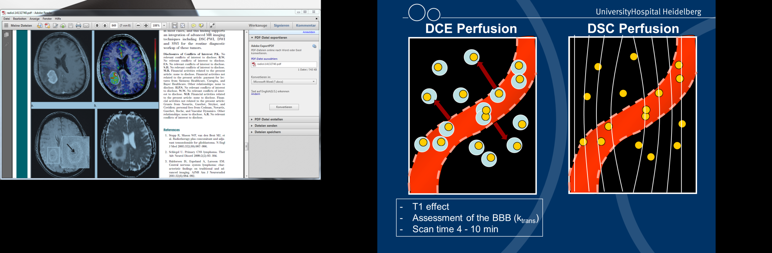
Underestimation of CBV
T1 and T2* effects are antagonistic
If DCE is perfomed prior to DSC Perfusion – Interstitium is saturated
Otherwise preload of contrast agent is needed prior to DSC Perfusion

Slide 20
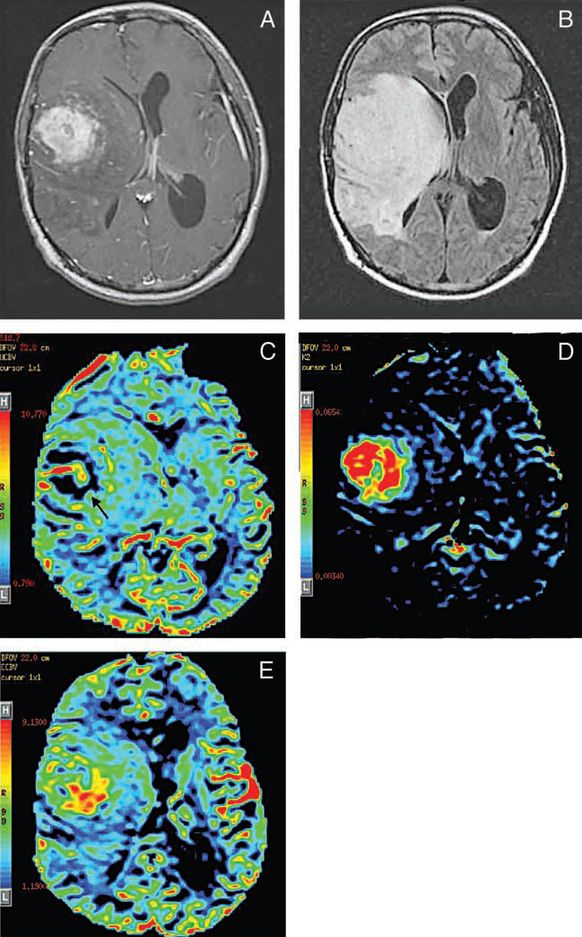
Underestimation of CBV
T1 and T2* effects are antagonistic
If DCE is perfomed prior to DSC Perfusion – Interstitium is saturated
Otherwise preload of contrast agent is needed prior to DSC Perfusion
Without correction techniques
With correction technique
Covarrubias, Rosen, Lev; The Oncologist 2004;9:528-537 “Dynamic Magnetic Resonance Perfusion Imaging of Brain Tumors”

Slide 21
Advanced imaging techniques for…
Differential diagnosis
Identification of pseudoprogression
Identification of pseudoregression / T2-progress

Slide 22
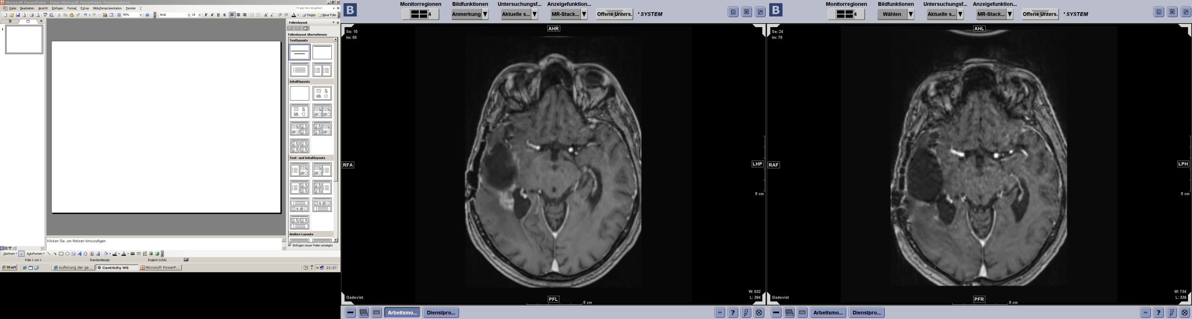
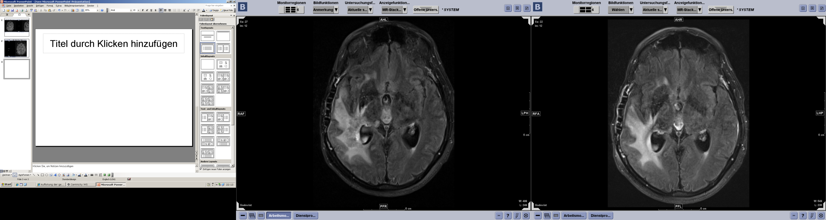
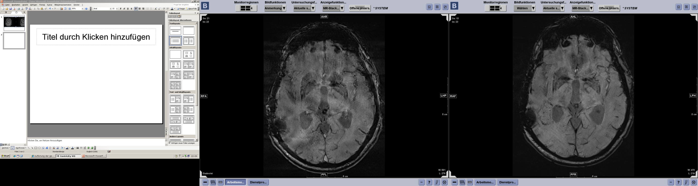

Pseudoregression and SWI
Baseline: Start of Bevacizumab
Follow up 3 months later:
Radbruch A, et al. Presented at the American Society of Neuroradiology 50th Anniversary Meeting. New York, New York, United States. April 21-26, 2012. Abstract: eP-86.

Slide 23
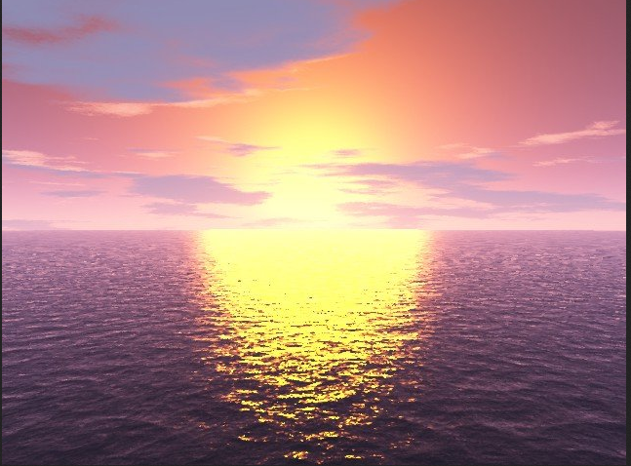
What is on the horizon?

Slide 24

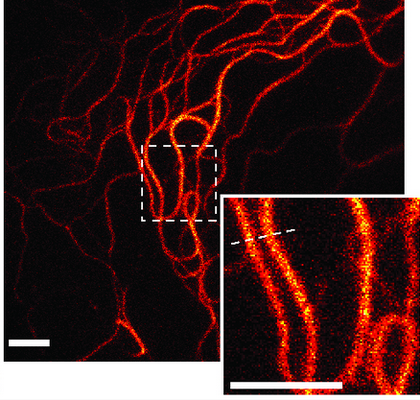
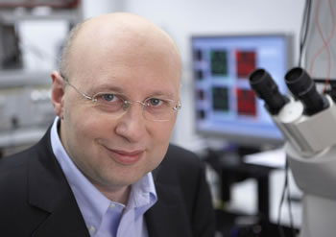
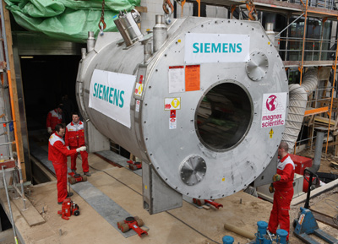
Increased spatial Resolution:
7 Tesla

Slide 25
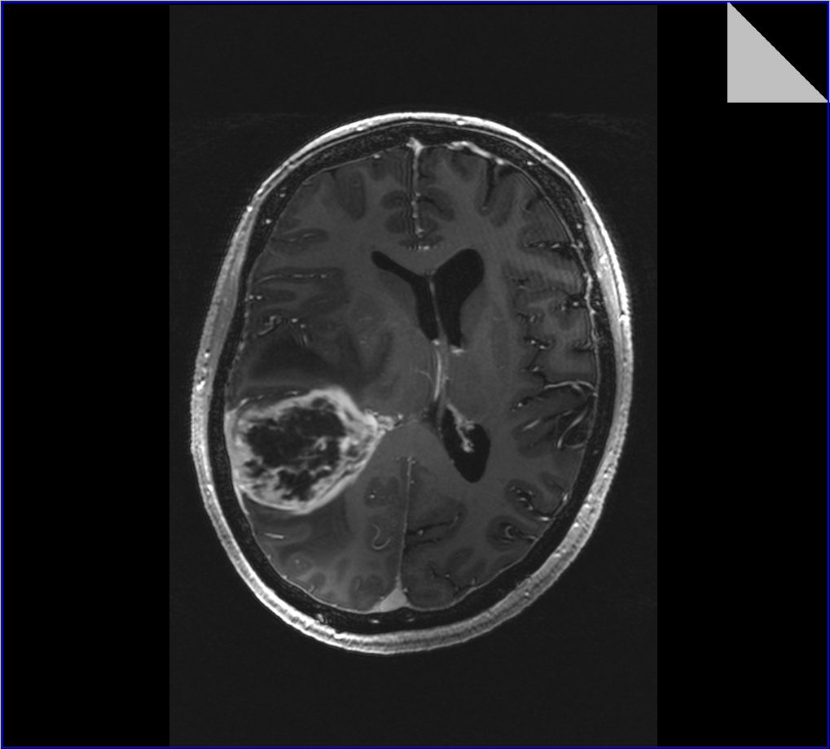
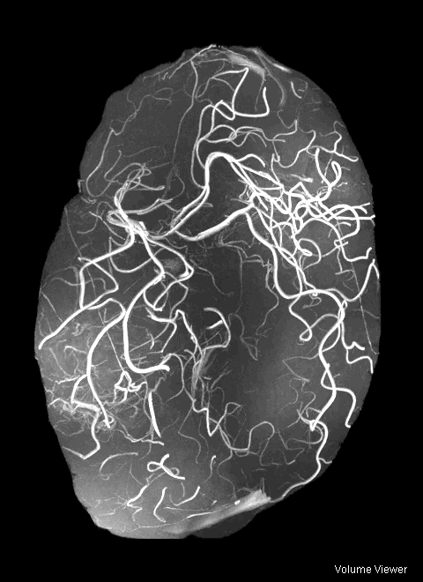
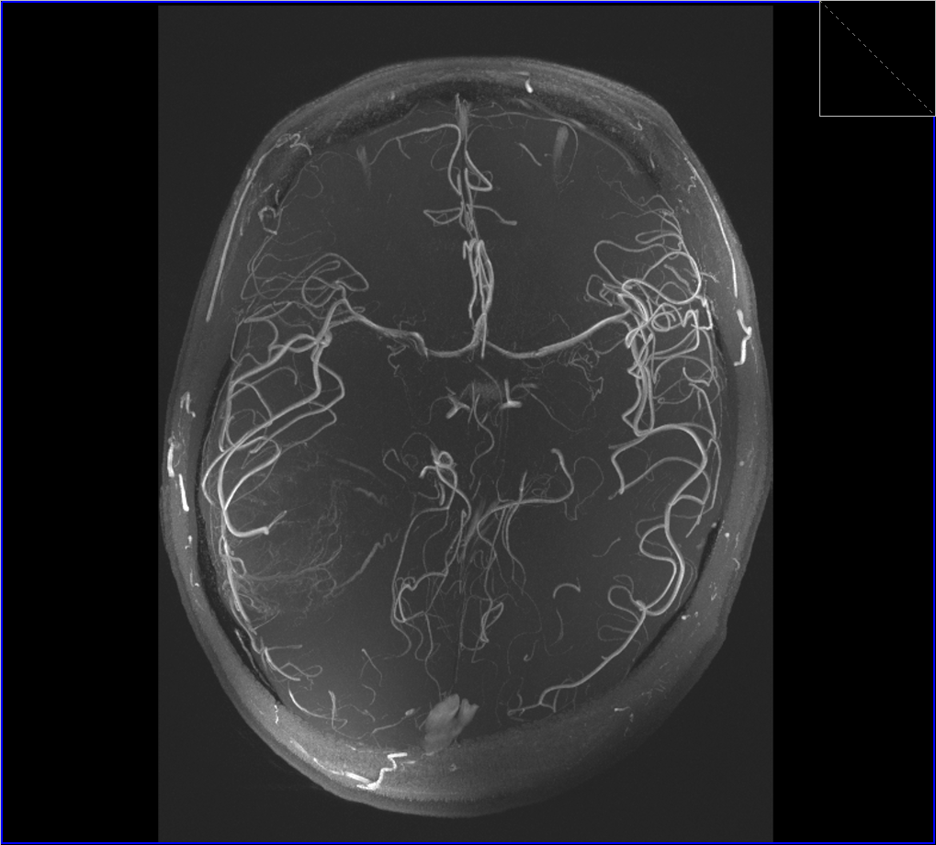
Notes:
SWI and TOF-Angiography do complement each other

Slide 26
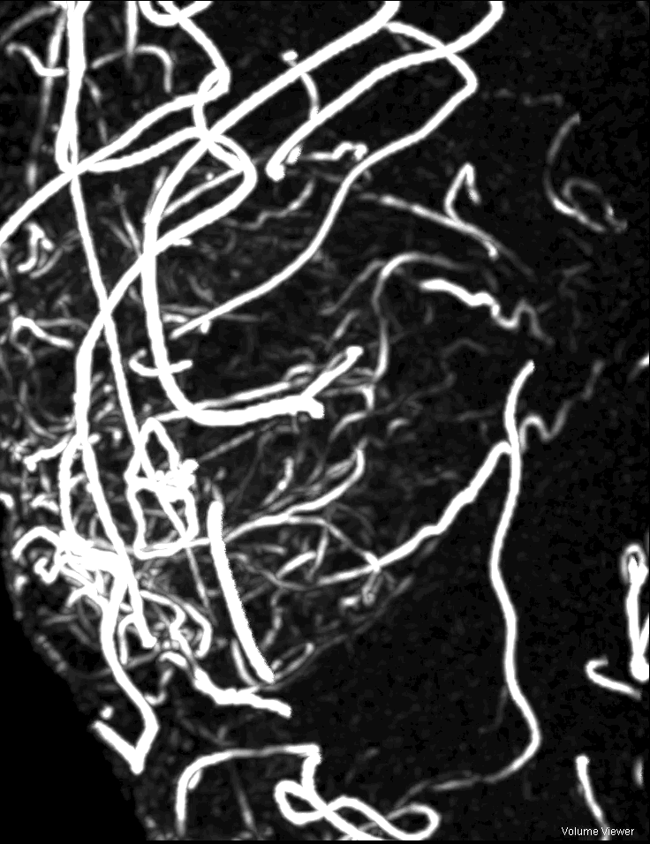
Conclusion
Advanced imaging techniques
improve differential diagnosis of GBM
improve identification of pseudoprogression/ pseudoregression
Multiparametric approach is essential
Standardization of Imaging parameters and multicenter studies are urgently needed
Thank you for your attention!

